Slide 1


Demand Forecasting and Waste Optimization Strategies for Doon Bites Restaurant
A BDM Capstone project by Rushil Gupta (21F1006728)

Slide 2
Contents
1. Executive Summary
2. Data Collection and Cleaning
3. Data Analysis
4. Results and Findings
5. Recommendations

Slide 3
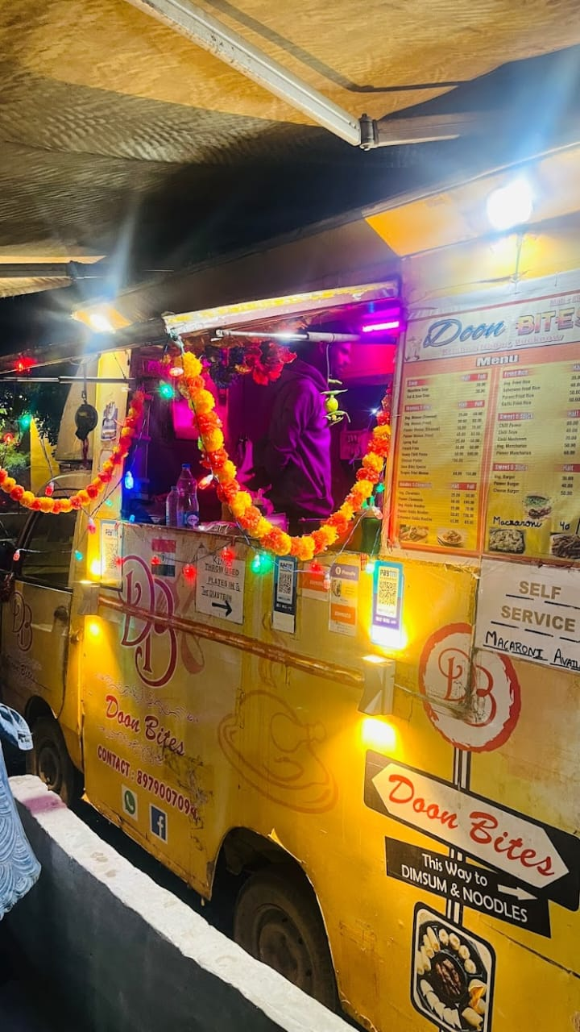
Executive Summary
Doon Bites Restaurant is a small food outlet in Lucknow owned by Mr. Mukul Rautela,
It had started its operations in early 2021 and specializes in vegetarian fast food dishes, particularly of Chinese cuisine.
The business operates on all days of the week from 5PM to 10PM. It is also available on Zomato and Swiggy.
Problems of this business included: large waste generation, inability to predict the demands of dishes and low profits.

Slide 4
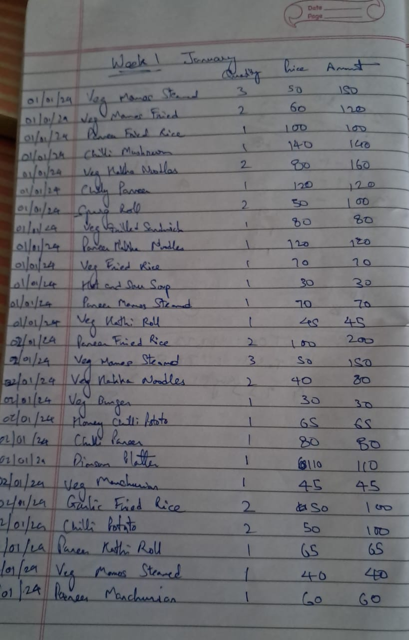
Data Collection and Cleaning
The data was collected for a period of 45 days, from 1st January 2024 to 15th February 2024.
The data consisted of sales and purchase data of the restaurant, and was stored in a raw format. (in a register)
Tools like Google lens was used to extract text from images of the register pages. This extracted text was then pasted into excel.
Data cleaning and pre-processing was done to remove incorrect values, and to ensure integrity of data captured.

Slide 5
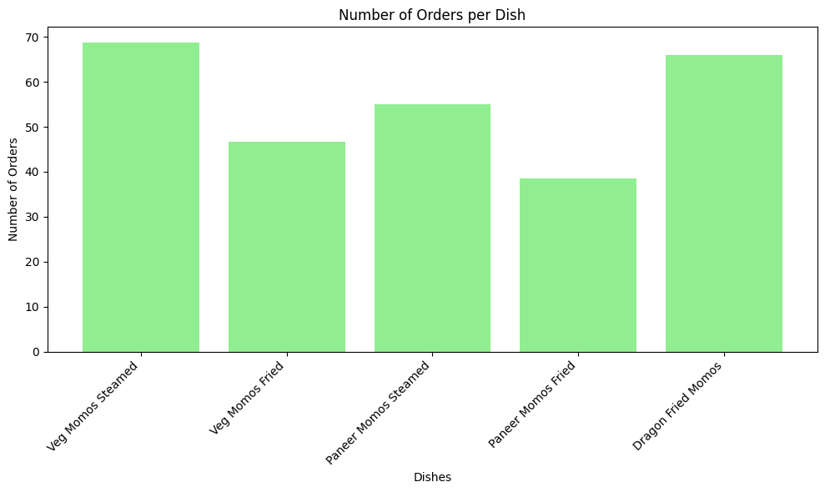
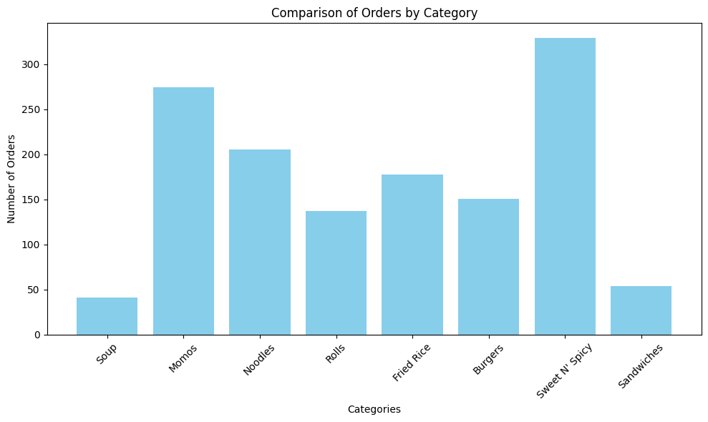
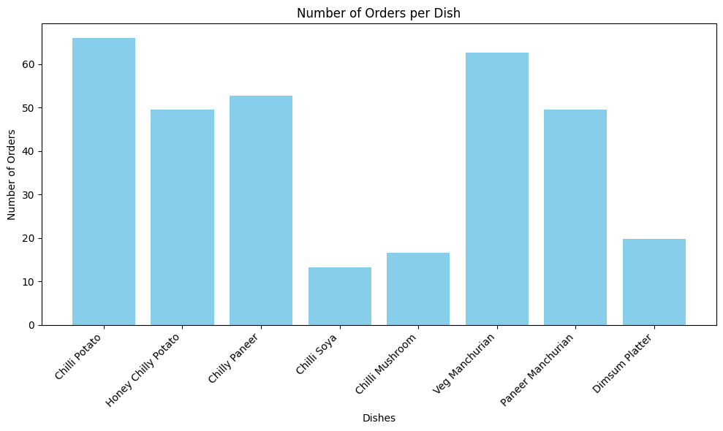
Data Analysis – Top Categories and Dishes

Slide 6
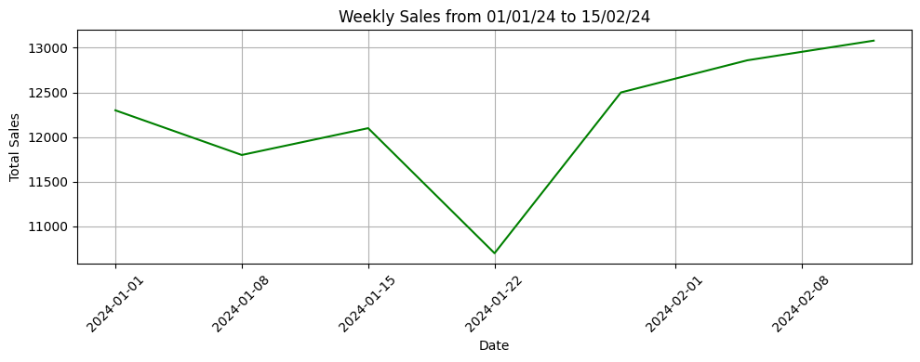
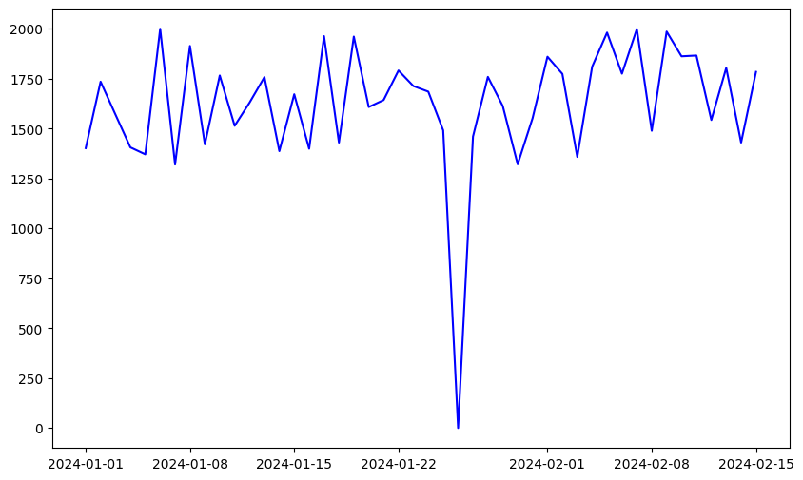
Data Analysis – Sales Trend
Weekly and Daily line charts plotted to identify the trend of sales with time.

Slide 7
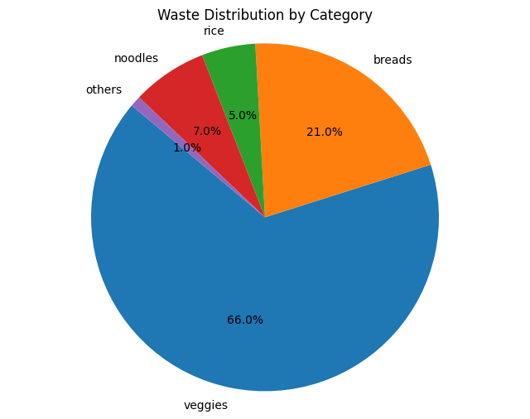
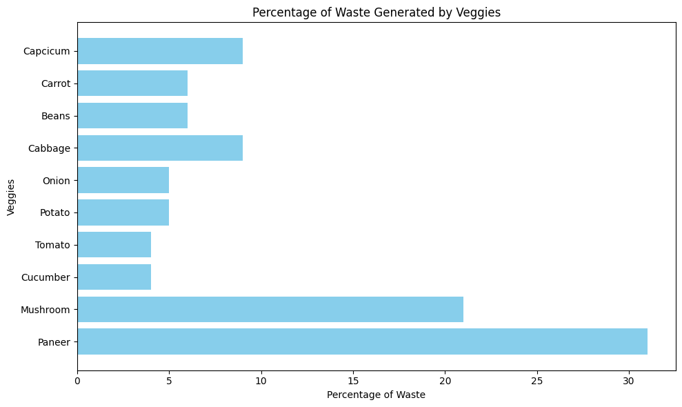
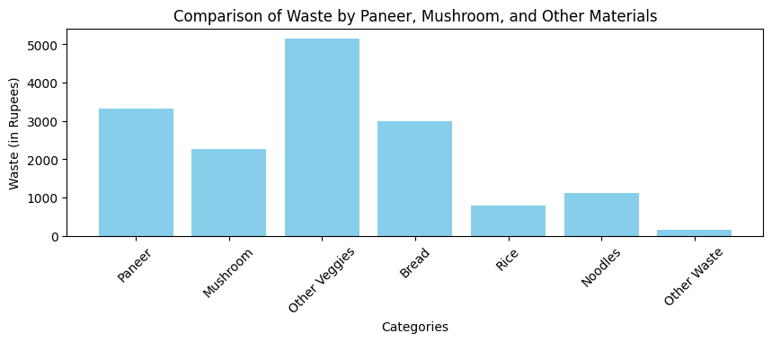
Data Analysis – Waste Analysis

Slide 8
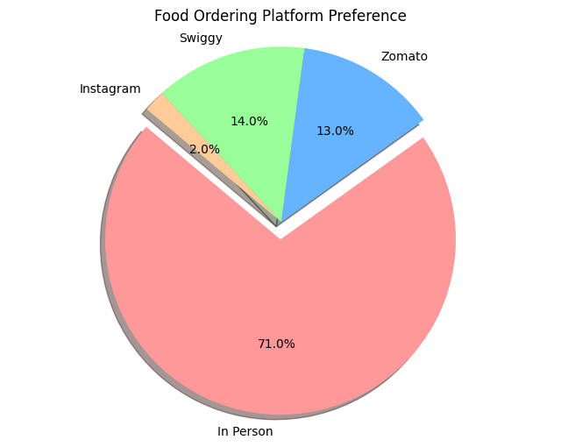
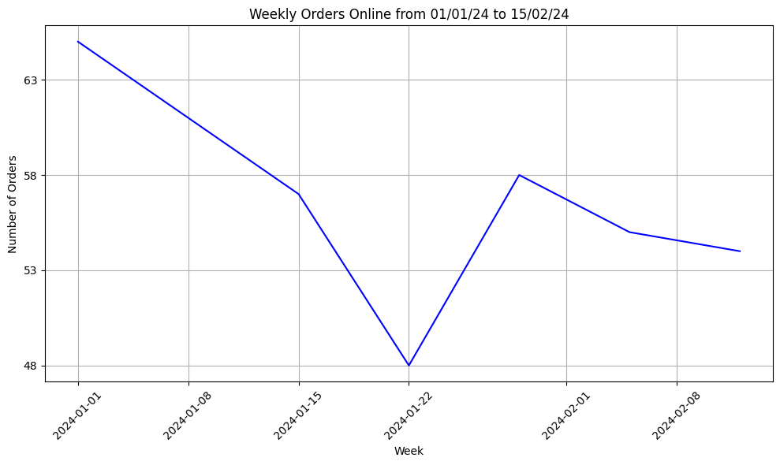
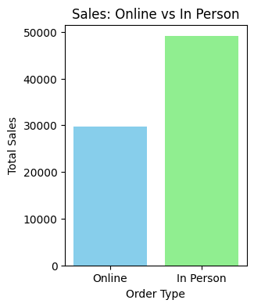
Data Analysis – Customer Order Preference

Slide 9
Results and Findings
A growing trend of sales and orders was observed
A declining trend of orders made online was observed.
Orders made online were approx. 1.5x bigger than the ones made in person.
Paneer, Mushroom and bread were the top contributors to raw material waste.
People prefer to order in person instead of ordering online from this business.
Momos and Sweet N’ Spicy were the top selling categories discovered.

Slide 10
Recommendations
Prioritize on top selling categories/dishes: Momos, Chilly Potatoes and Manchurian. Ensure there is sufficient raw material available for them at all times.
Promote high demand dishes as USP, such as Dragon Fried Momos.
Remove Sandwiches from the menu. Consider removing Chilly Soya too.
Reduce purchase of Paneer by 50% and purchase of Mushrooms by 66%.
Restock inventory less frequently (2x/week) for veggies with longer shelf life. Buy in Bulk.
Offer discounts, loyalty benefits and combos to lure and retain declining online customers.

